Slide 1

Principles of communications
Chapter2 Random processes— Part II

Slide 2
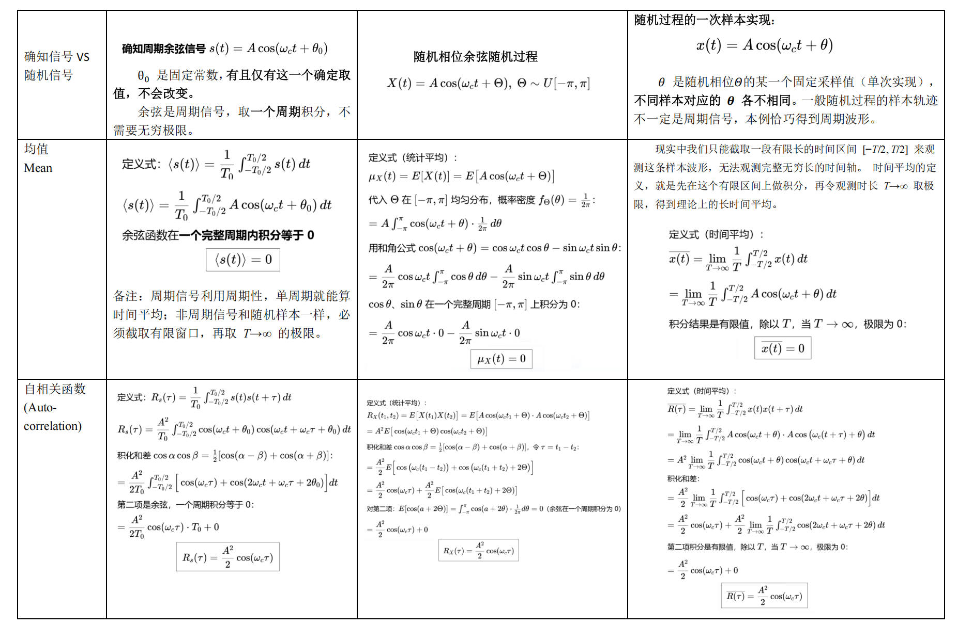
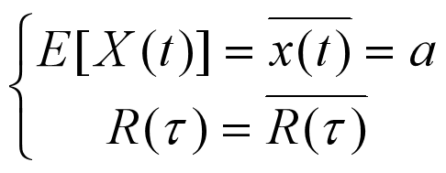
知识点回顾
Stationary random process

Slide 3
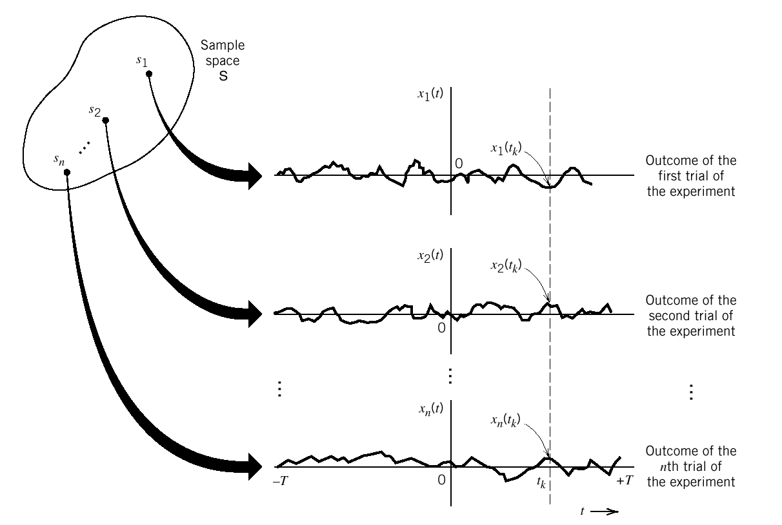


Stationary random processes
局部→ 整体

Slide 4
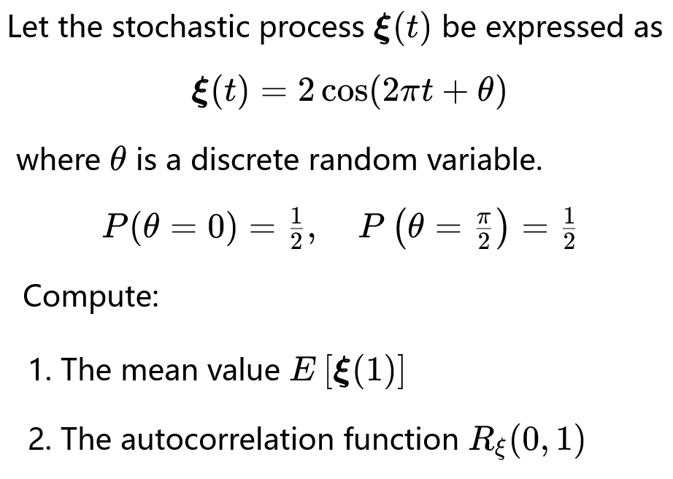

Example 1

Slide 5
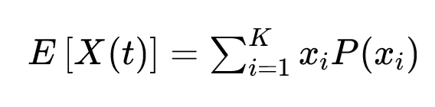
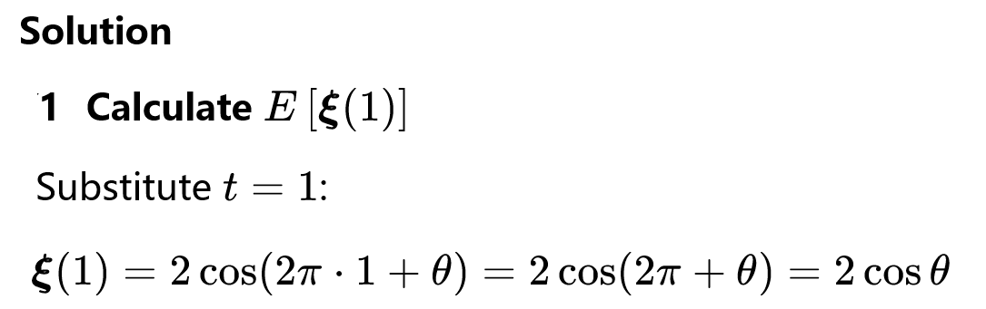
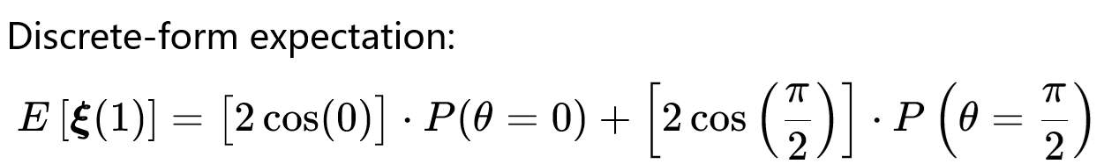
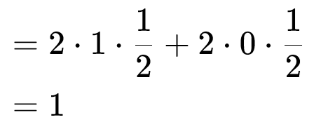

Slide 6
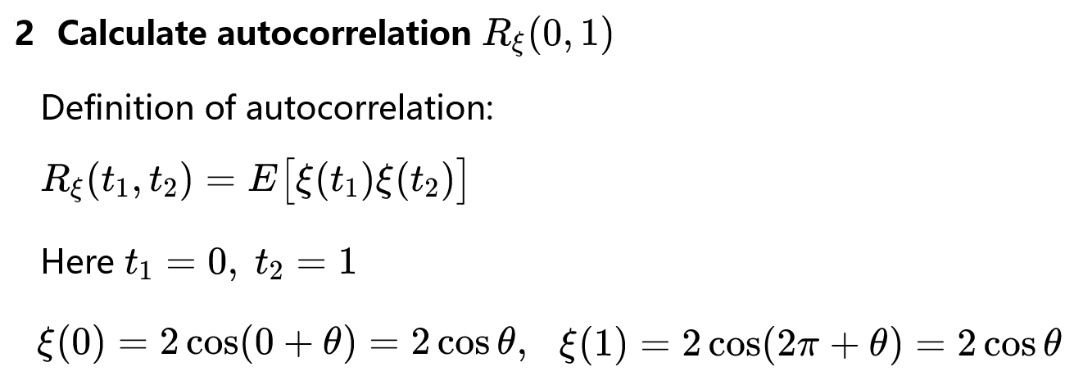

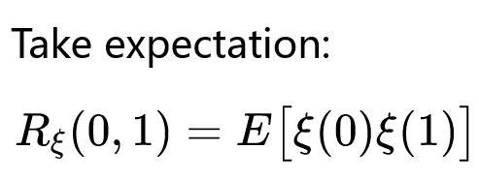
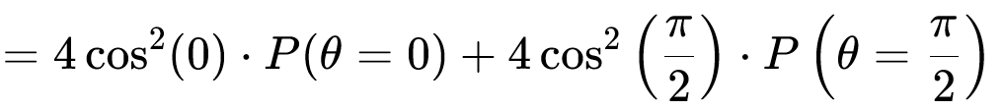
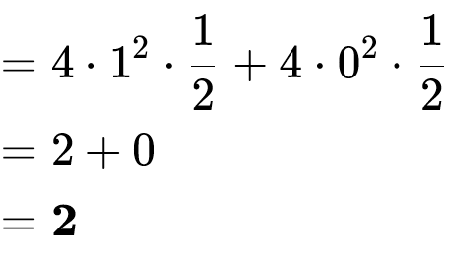
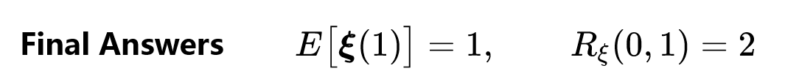

Slide 7
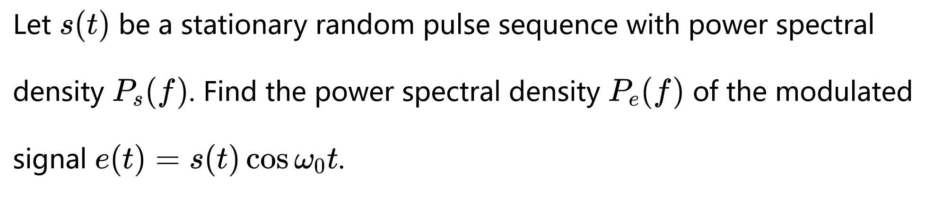
Example 3

Slide 8
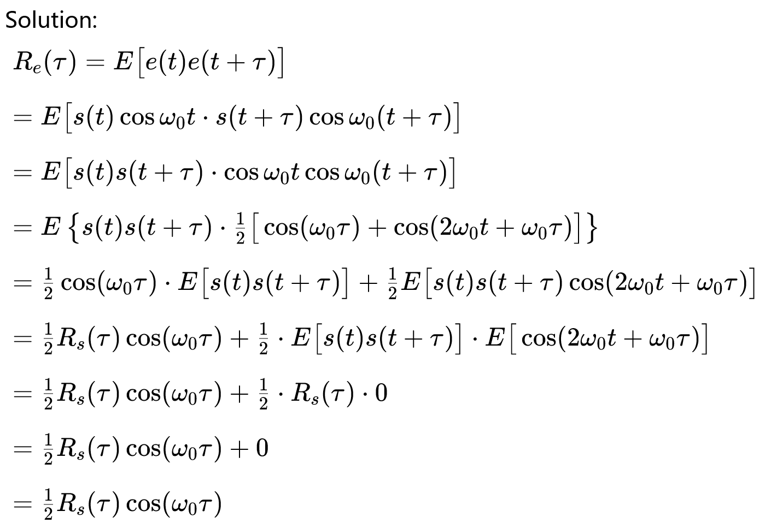

statistically independent

Slide 9
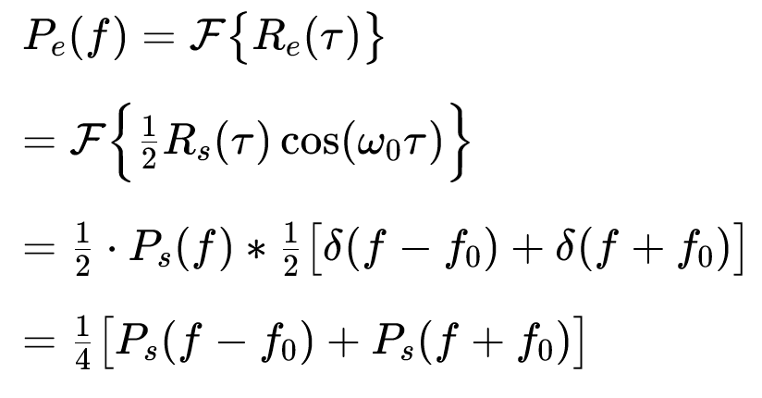

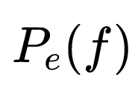
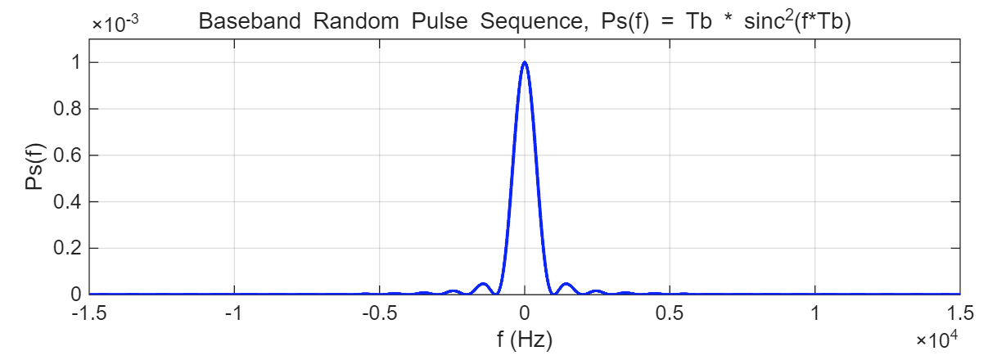
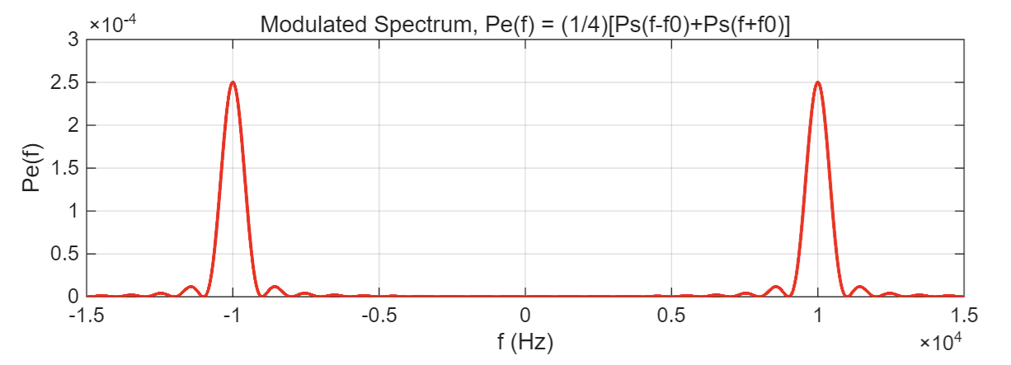
维纳辛钦关系
modulator
Power Spectra of Stationary Random Pulse Sequence Before and After Modulation

Slide 10
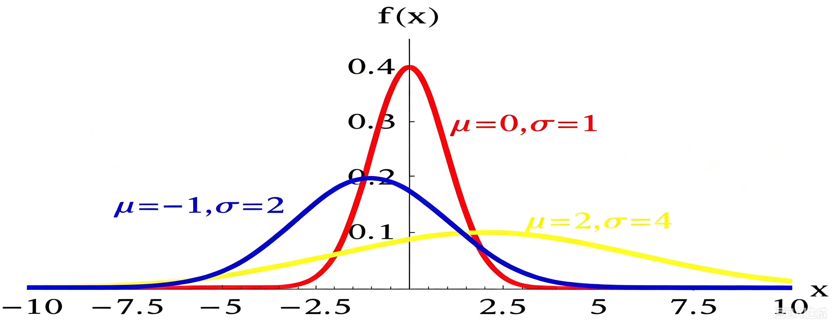
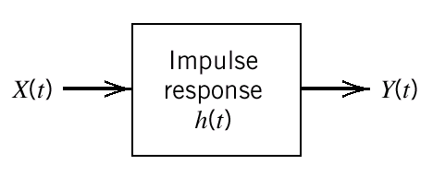
Chapter 2：Random Processes——Part II
Stationary Processes：局部替代整体
Gaussian Random Processes
Random Processes Passing through Linear Systems

Slide 11
Chapter 2：Random Processes——Part II
Stationary Processes
--Definitions ① ② and Ergodicity
--Properties of the Autocorrelation Function
--Power spectral density：PSD
Gaussian Random Processes
Random Processes Passing through Linear Systems

Slide 12
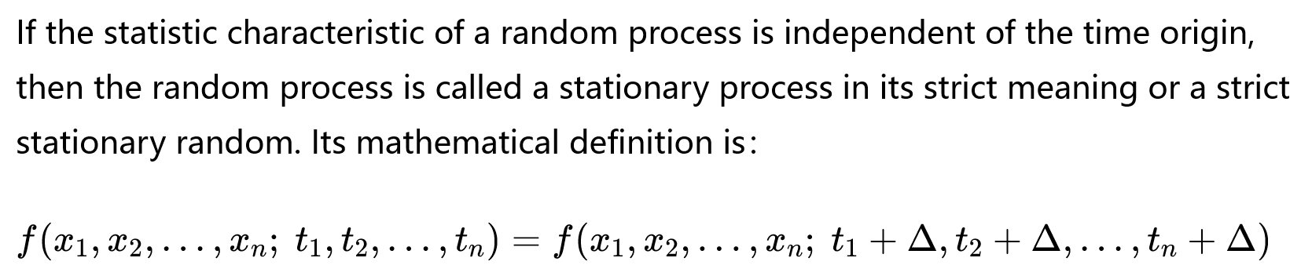
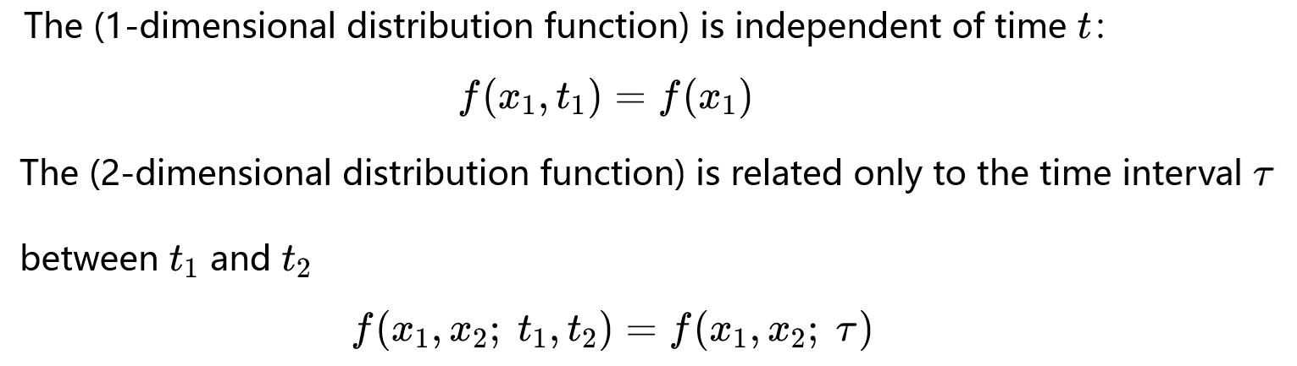
Chapter 2：Random Processes——Part II
Stationary Processes
--Definitions ① Stationary in the strict-sense（严平稳）
Independent of the time origin
(与起点无关)
与时间无关
只与时差有关

Slide 13
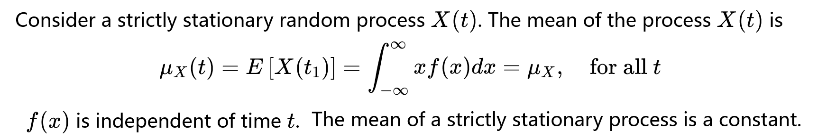
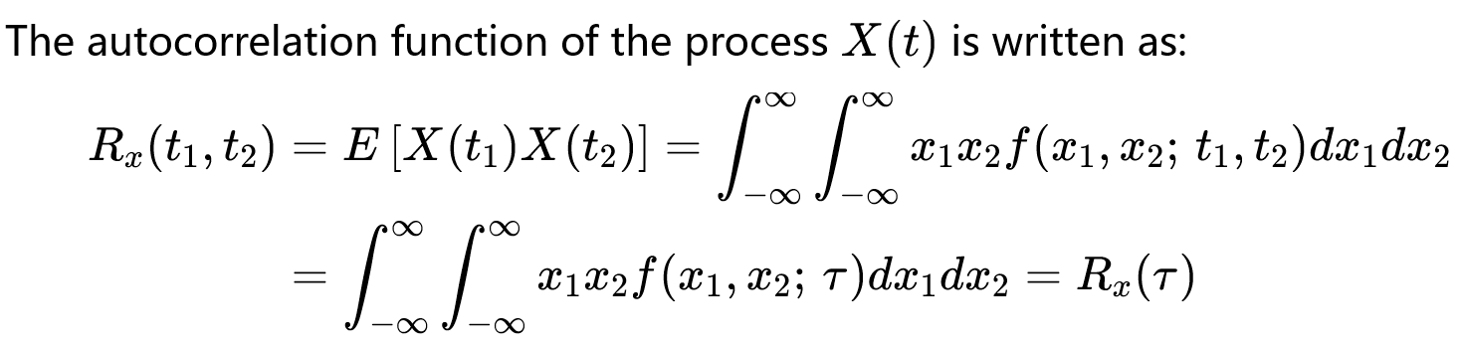

Chapter 2：Random Processes——Part II
Stationary Processes
--Definitions ② Stationary in wide-sense（宽平稳）

Slide 14

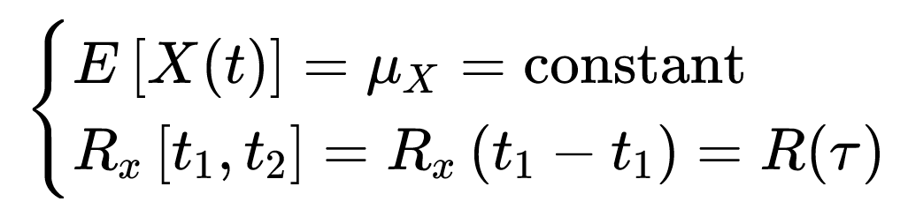

Chapter 2：Random Processes——Part II
Stationary Processes
--Definitions ② Stationary in wide-sense（宽平稳）
  ⭕Mean is a constant and auto-correlation function depends only on
  ⭕Often used in practice.
  ⭕Not necessary strictly stationary.
A strictly stationary random process is always wide-sense stationary
A wide-sense stationary process is not necessarily strictly stationary.

Slide 15
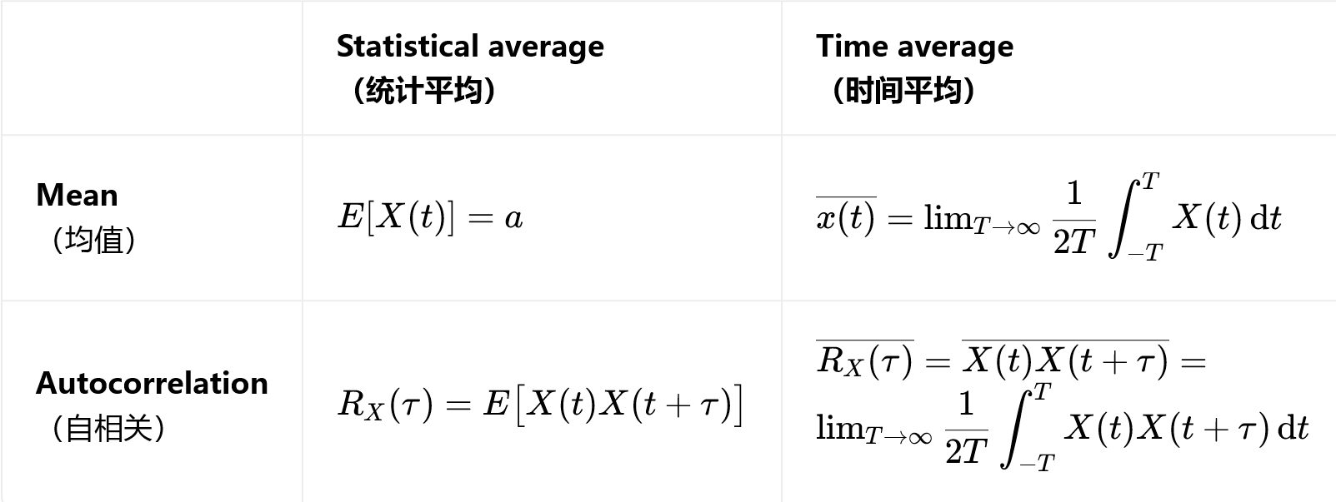
Chapter 2：Random Processes——Part II
Stationary Processes —— 各态历经性 Ergodicity
Ergodicity

Slide 16
Chapter 2：Random Processes——Part II
Stationary Processes
判断(T or F):讨论
( )Any ergodic random process must be wide-sense stationary.
( )A strictly stationary random process is always ergodic.
( )All wide-sense stationary processes are strictly stationary.
Ergodic process ⇒ Strictly stationary ⇒ Wide-sense stationary

Slide 17
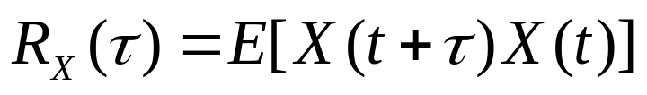
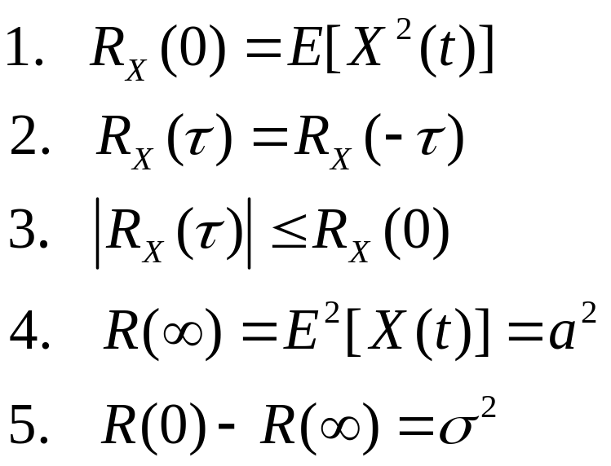
Chapter 2：Random Processes——Part II
Stationary Processes
--Definitions ① ② and Ergodicity
--Properties of the Autocorrelation Function
Average Power 平均功率
Even function 偶函数
has an upper bound
D.C.power 直流功率
A.C.power 交流功率

Slide 18
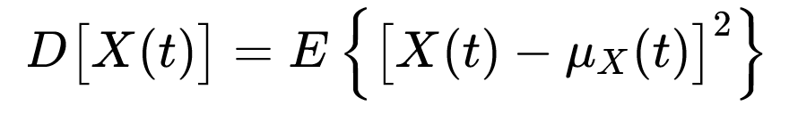
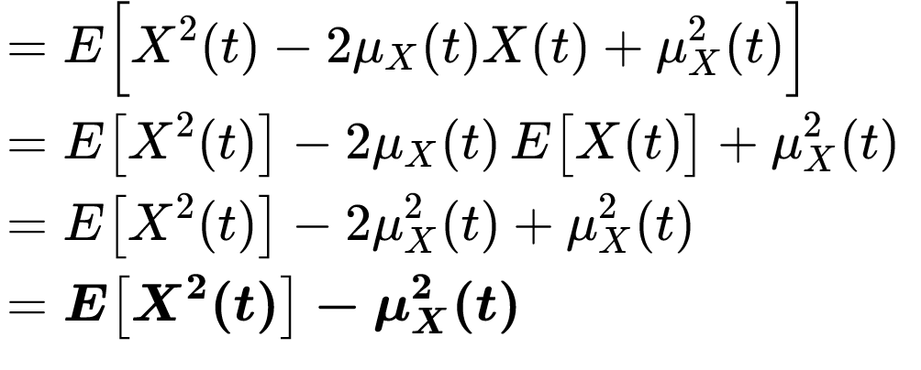
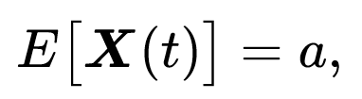
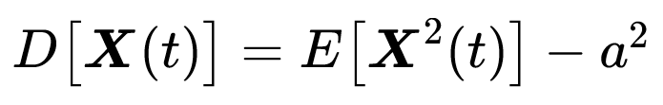
均方值
均值平方
Square of the mean
Mean square
If then

Slide 19
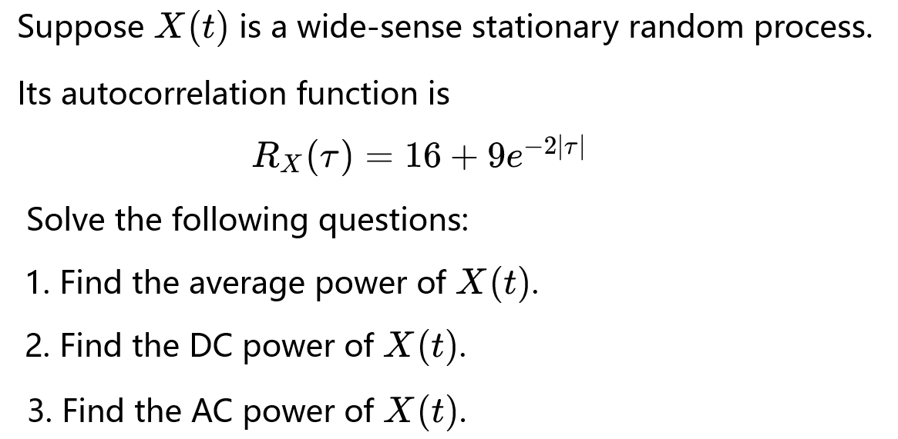
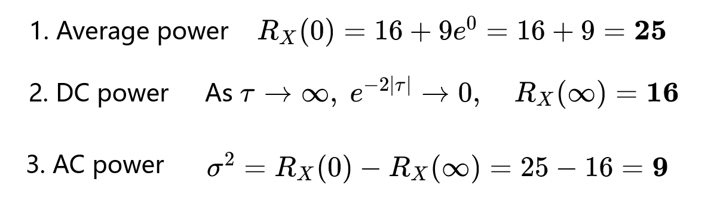
Solution

Slide 20
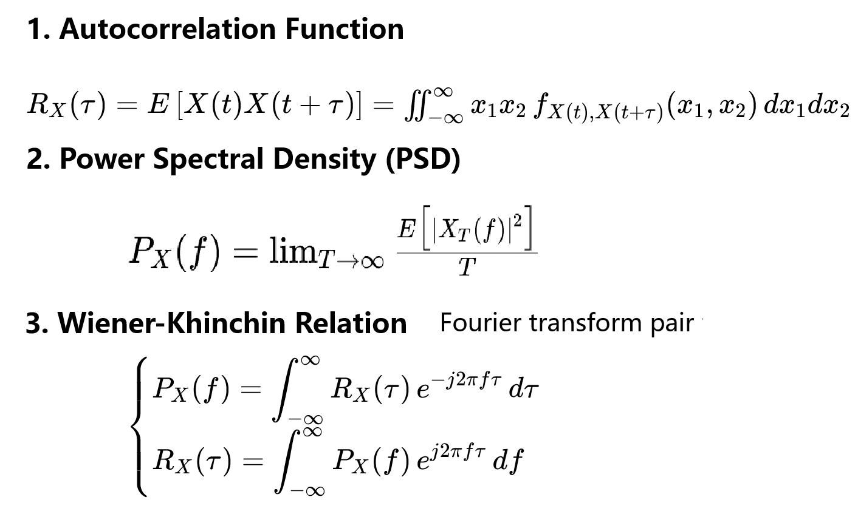
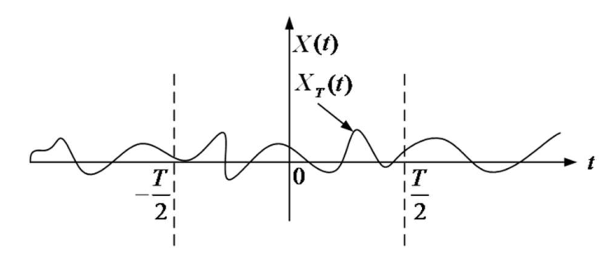

Stationary Processes
--Definitions ① ② and Ergodicity
--Properties of the Autocorrelation Function
--Power spectral density：PSD
维纳辛钦定理
Wiener–Khinchin Theorem

Slide 21
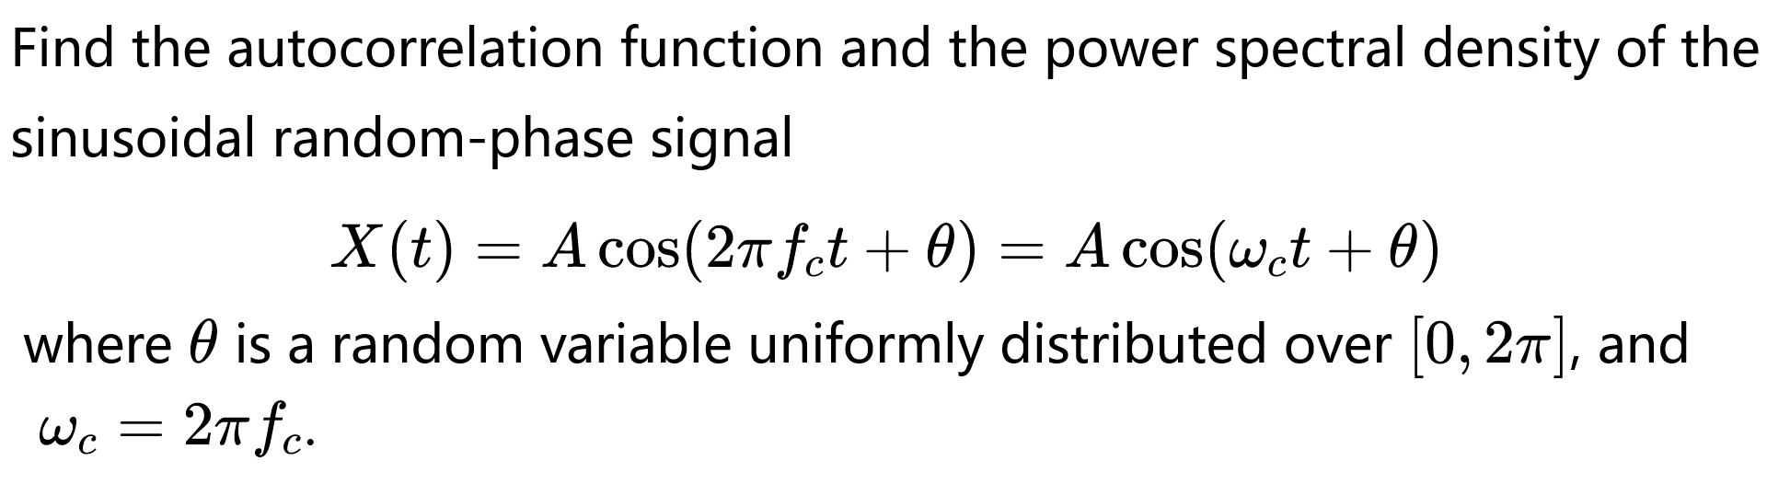
Stationary Processes
--Definitions ① ② and Ergodicity
--Properties of the Autocorrelation Function
--Power spectral density：PSD
Example

Slide 22
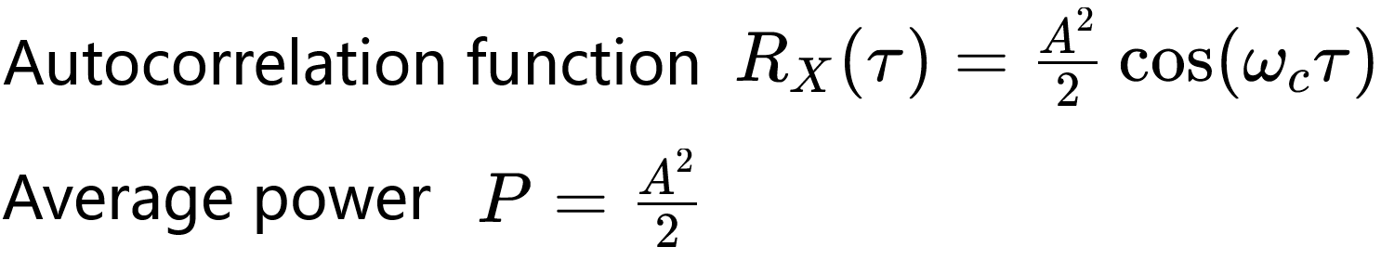

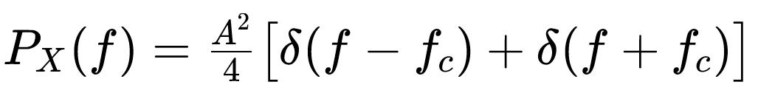

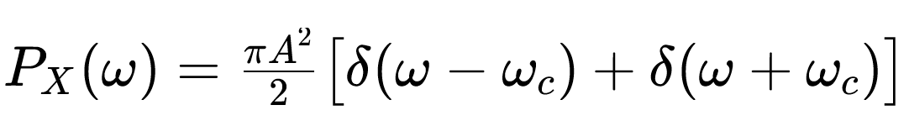
Example

Slide 23
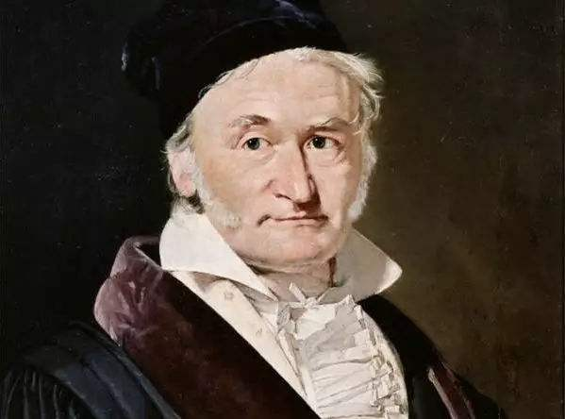
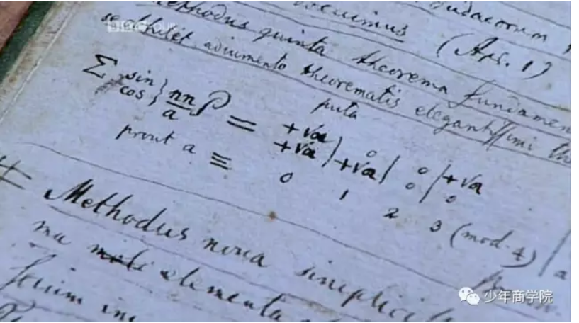

Chapter 2：Random Processes——Part II
Stationary Processes
--Definitions ① ② and Ergodicity
--Properties of the Autocorrelation Function
--Power spectral density：PSD
Gaussian Random Processes
--Definition
--Properties
--Gaussian random variable

Slide 24
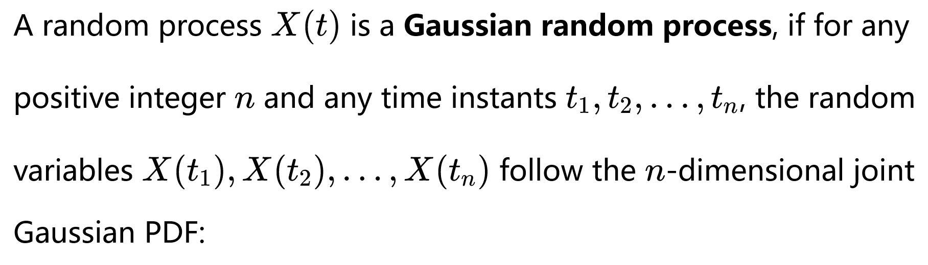
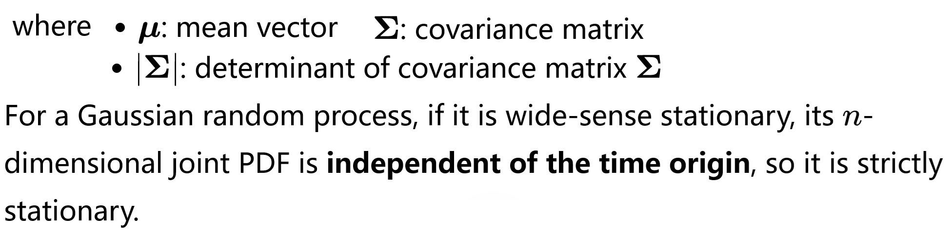

Gaussian Random Processes—— Definition

Slide 25
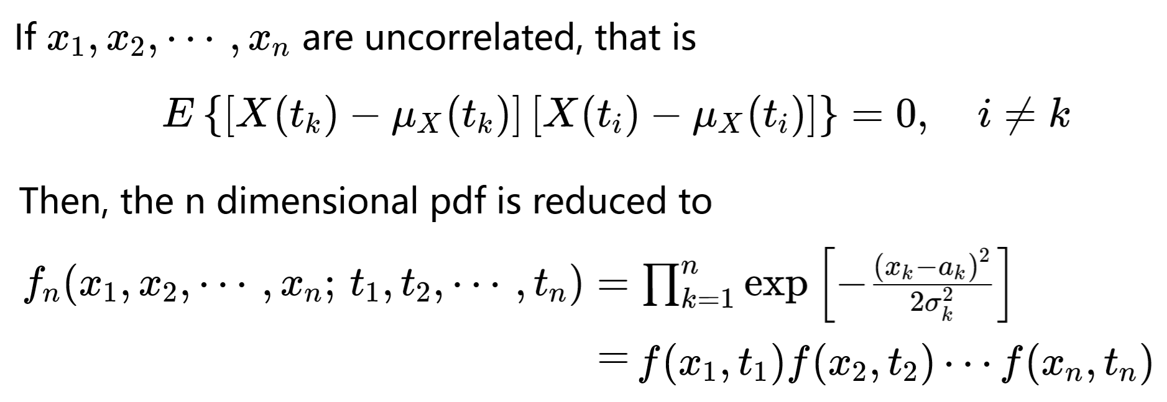
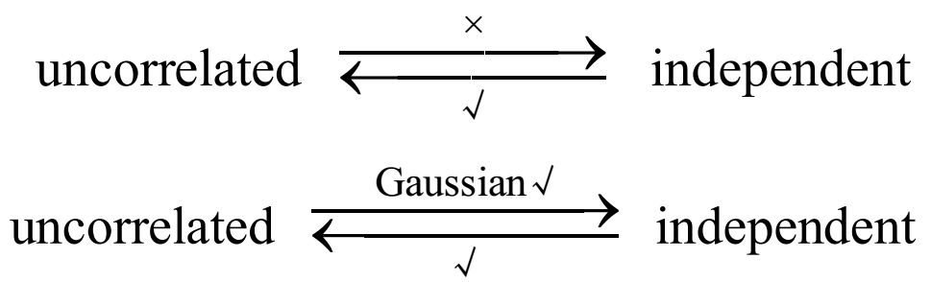
Gaussian Random Processes
● Definition
● Properties
● Gaussian random variable
Uncorrelated:不相关
statistically independent: 统计独立

Slide 26
Gaussian Random Processes
● Definition
● Properties
● Gaussian random variable
判断(T or F):讨论
( ) For a general random process, strict-sense stationary
implies wide-sense stationary.
( )If two random variables are uncorrelated, they must be
statistically independent.
( )For Gaussian random variables, uncorrelated means
statistically independent.

Slide 27
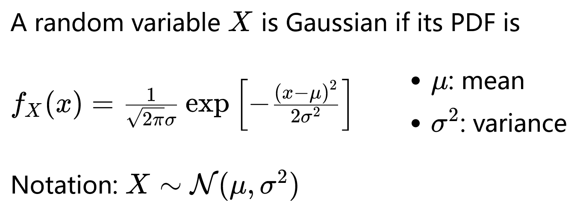
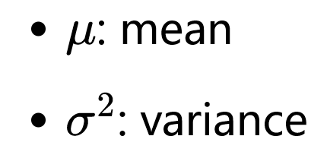
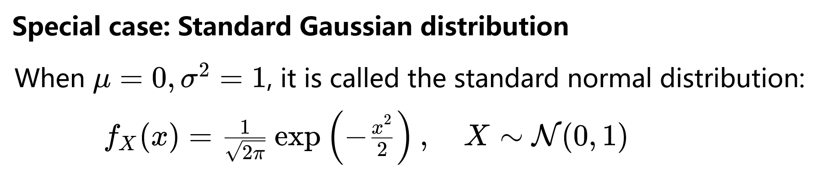
Gaussian Random Processes
● Definition
● Properties
● Gaussian random variable

Slide 28




扩展：Gaussian 分布计算误码率Pe
● Complementary Error Function: erfc(x)
● BPSK Bit Error Probability (AWGN Channel)

Slide 29


扩展：Gaussian 分布计算误码率Pe
● BPSK Bit Error Probability (AWGN Channel)

Slide 30



扩展：Gaussian 分布计算误码率Pe
● BPSK Bit Error Probability (AWGN Channel)

Slide 31




Chapter 2：Random Processes——Part II
Stationary Processes
Gaussian Random Processes
Random Processes Passing through Linear Systems
是功率增益
结论1：If a wide-sense stationary (WSS) random process X(t) is the input to a linear time-invariant (LTI) system, the output random process Y(t) is also wide-sense stationary.
若广义平稳随机过程X(t)输入线性时不变(LTI)系统，则输出随机过程Y(t)同样是广义平稳的。

Slide 32
Chapter 2：Random Processes——Part II
Stationary Processes
Gaussian Random Processes
Random Processes Passing through Linear Systems
是功率增益
结论2 ：If the input random process is a Gaussian process, then the output random process is also a Gaussian process.
(如果线性系统输入过程是高斯的,则系统的输出过程也是高斯的)

Slide 33



Chapter 2：Random Processes——Part II
Random Processes Passing through Linear Systems

